Slide 1

ModelIt!
Student Lesson
The Mushroom Network Under Your Feet
Trees Share Food and Warnings Through Underground Internet
NGSS: 5-LS2-1
5th Grade
1/9

Slide 2
What You Will Learn Today
Learning Goals
* Identify mycorrhizal fungi as active participants in ecosystem matter cycling
* Model how organic matter and moisture drive fungal network health
* Explain how the fungal network enables nutrient transfer between trees
* Predict what happens to forest health when the network is disrupted
Key Vocabulary
Mycorrhizal
Related to fungi that form partnerships with plant roots
Mutualism
A relationship where both organisms benefit
Hyphae
Tiny thread-like structures that form fungal networks
Nutrient
Substances that living things need to grow and survive
2/9

Slide 3
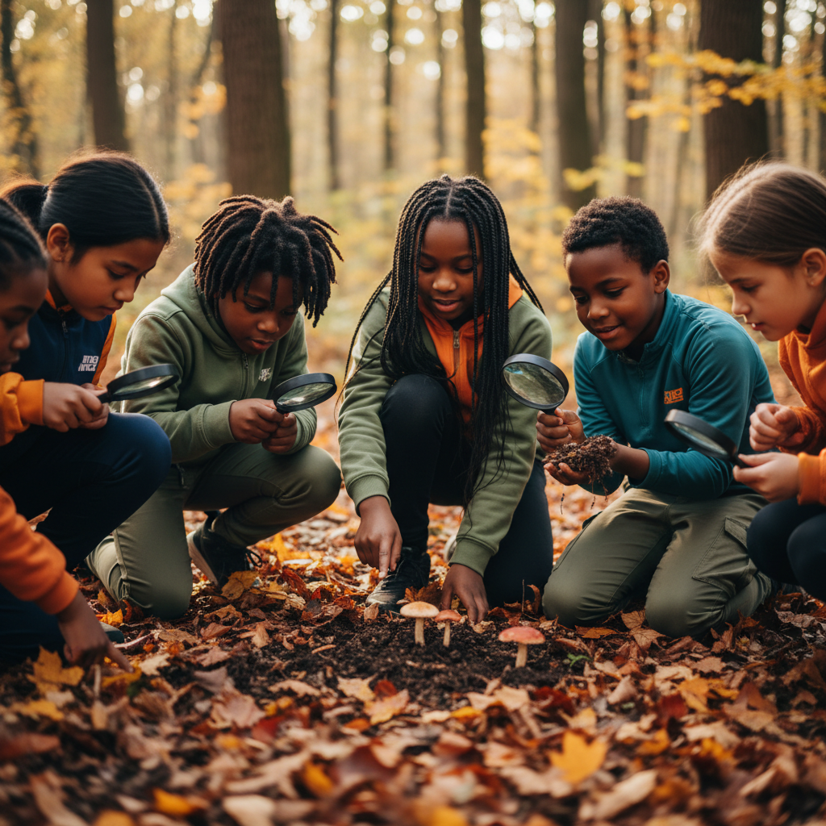
The Big Question
How do underground conditions control how much trees can share with each other?
Trees Share Food and Warnings Through Underground Internet. Today we'll build a MODEL to discover the answer!
3/9

Slide 4

Today We Will Build a Model!
A model helps us understand complex systems!
1. LOCATE
Identify the COMPONENTS (parts) of the system
2. ESTABLISH
Connect them with RELATIONSHIPS (+ or -)
3. VISUALIZE
Build your model in ModelIt!
4. EVALUATE
Run SIMULATIONS to test scenarios
5. REVISE
Improve your model based on evidence
4/9

Slide 5

Activity 1: Sort the Components
Sort these components into EXTERNAL (inputs from outside) and INTERNAL (inside the system):
Your Components:
* Leaf Litter / Organic Matter
* Soil Moisture
* Mycorrhizal Fungal Network Activity
* Nutrient Transfer Between Trees
Think: Which components can we control? Which happen on their own?
5/9

Slide 6
Activity 2: Connect with Arrows
Draw arrows to show HOW components affect each other:
(+) POSITIVE Relationship
When one goes UP, the other goes UP too
(-) NEGATIVE Relationship
When one goes UP, the other goes DOWN
Think About It:
If fungi need food and water, what happens to the forest network during a drought?
6/9

Slide 7
Activity 3: Run the Simulation!
Test these scenarios in ModelIt!
Healthy Forest
Normal organic matter and soil moisture
Drought
Lock Soil Moisture to 10%
Clear-Cut Aftermath
Lock Leaf Litter to 0%
Watch the activity graphs change!
[ModelIt Platform Screenshot - Simulation Results Graph]
7/9

Slide 8
What Did We Discover?
Our Model Showed Us:
* Trees are connected underground through fungal threads
* The network allows trees to share sugar and warnings
* Drought isolates trees by shutting down the network
* Replanting a cleared forest takes decades because the network must rebuild
Answer: Trees share nutrients through an underground 'internet' of fungal threads. This network needs both organic matter and moisture to function!
8/9

Slide 9
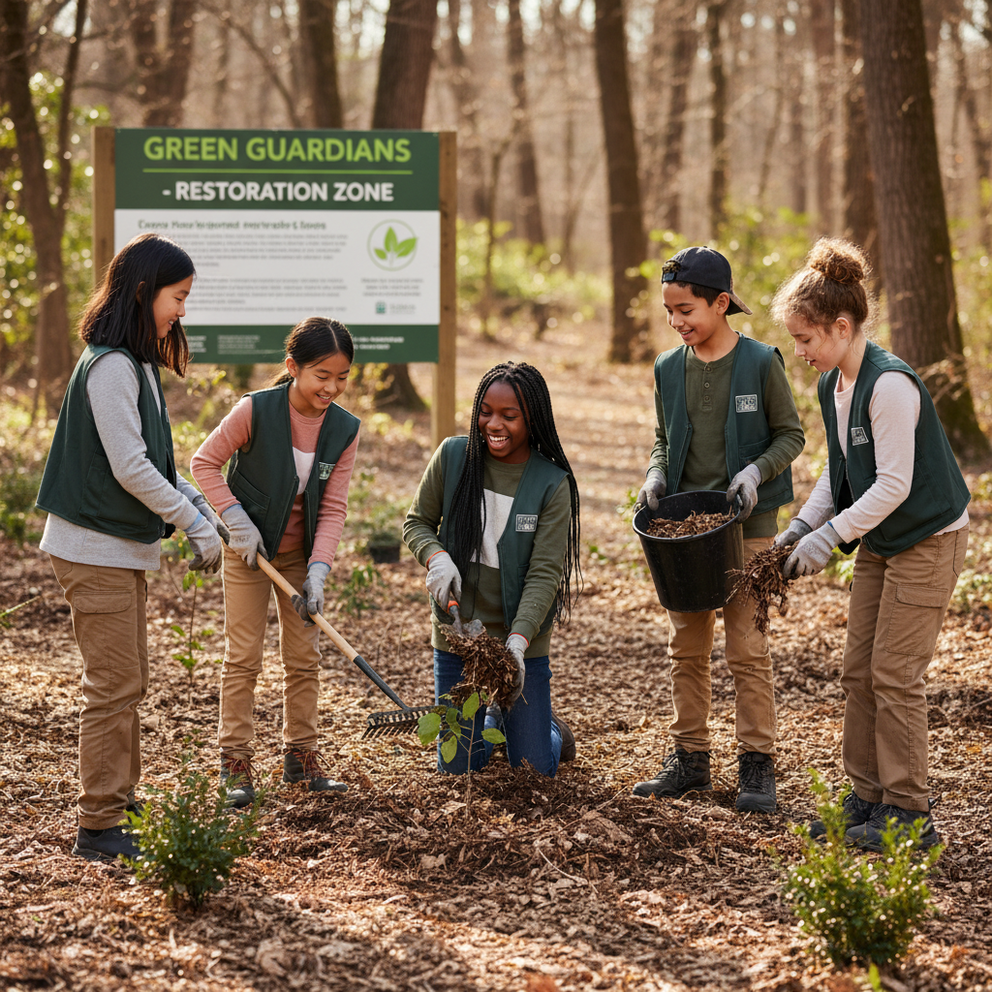
STEM Challenge: Design Forest Recovery Plan
YOUR ENGINEERING MISSION
Design a plan to restore the mycorrhizal network in a cleared forest.
The Challenge:
A forest was clear-cut 5 years ago. New trees are struggling. Design a plan to restore the underground network.
Think Like an Engineer:
* How can you reintroduce mycorrhizal fungi to the soil?
* What conditions do fungi need to establish themselves?
* How can you maintain moisture and organic matter?
REAL CAREER CONNECTION: Mycologists and Forest Ecologists study the underground networks that hold forests together. They earn $55,000-$90,000/year. The skills you're using TODAY are the same ones they use on the job!
9/9

